Slide 1
Version Control Systems (Git and GitHub)

Slide 2
Version Control Systems (VCS)
Essential for managing software development projects
Helps teams track code changes
Allows multiple people working on the same project at once
Protects the source code from unintended human errors (if done correctly)

Slide 3

Why should I use it?
Lab are collaborative environments
Many researchers working from similar code bases
It's hard to remember
What did I have for breakfast yesterday?
What code changes did I make last year?
Mistakes happen
I didn't delete that, did I?

Slide 4
Let's Try It! Using GitHub

Slide 5
Navigate to: https://github.com/nuitrcs/GitHub_Bootcamp

Slide 6
Set up ssh keys
Open a terminal on your computer
Run:
ssh-keygen -a 100 -t ed25519 -f ~/.ssh/id_ed25519 -C "bootcamp_key"
Navigate to the .ssh directory and run:
cat id_ed25519.pub
Copy the output of this file

Slide 7


Set up ssh keys - continued
Navigate to the GitHub website
Profile picture -> Settings -> SSH and GPG Keys -> New SSH Key
Paste in the output from the .pub file

Slide 8
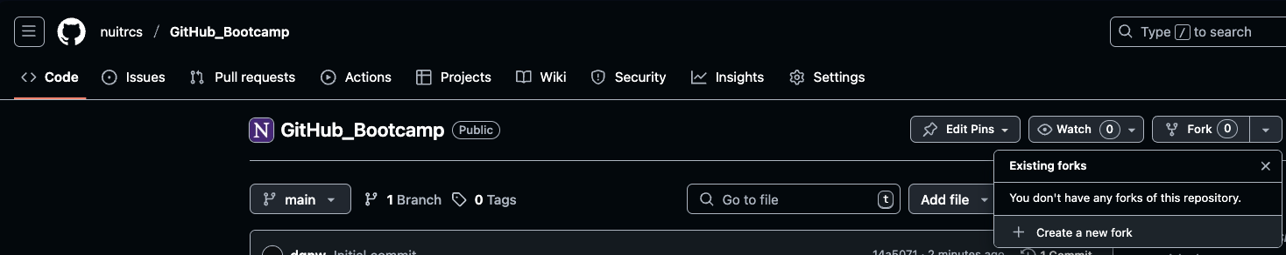
Fork the repo

Slide 9
Cloning and Branches
Reopen the terminal on your local computer and run:
git clone git@github.com:nuitrcs/GitHub_Bootcamp.git
Next, navigate into the cloned repository and create a branch
cd GitHub_Bootcamp
git checkout –b "branch_name"

Slide 10
Making and pushing changes
Edit the "Readme" file found in the repository
To add and push the changes, run:
git add .
git commit –m "Change description"
git push
Navigate to the website and open a pull request (PR) to merge the changes in
Note: be careful to select which repo to merge the branch in to

Slide 11
I don't Git it...

Slide 12
Git and GitHub
Software vs Service
Git: locally installed version control system
GitHub: Cloud-based platform that hosts Git repositories and provides additional collaboration features, as well as tracking issues and changes
Git is the underlying technology that GitHub uses to store and manage code

Slide 13
Git the Basics
Many different terms: pull, push, upstream, main, branch, fork, clone, merge, pull request
These are not random words
Most important:
There is a remote version (cloud hosted)
There is a local version (your laptop or Quest)
There are processes to communicate between the two

Slide 14


Ideology of Git
OR

Slide 15
Common Git Workflow
Find a repo in the browser
Clone the repo locally
Create a branch locally for changes
Make changes
Push those changes to the remote copy of the branch
Open a pull request (PR)
Merge the PR back in to main
Profit

Slide 16
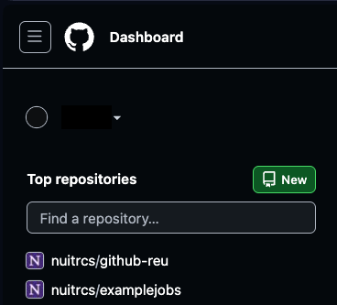
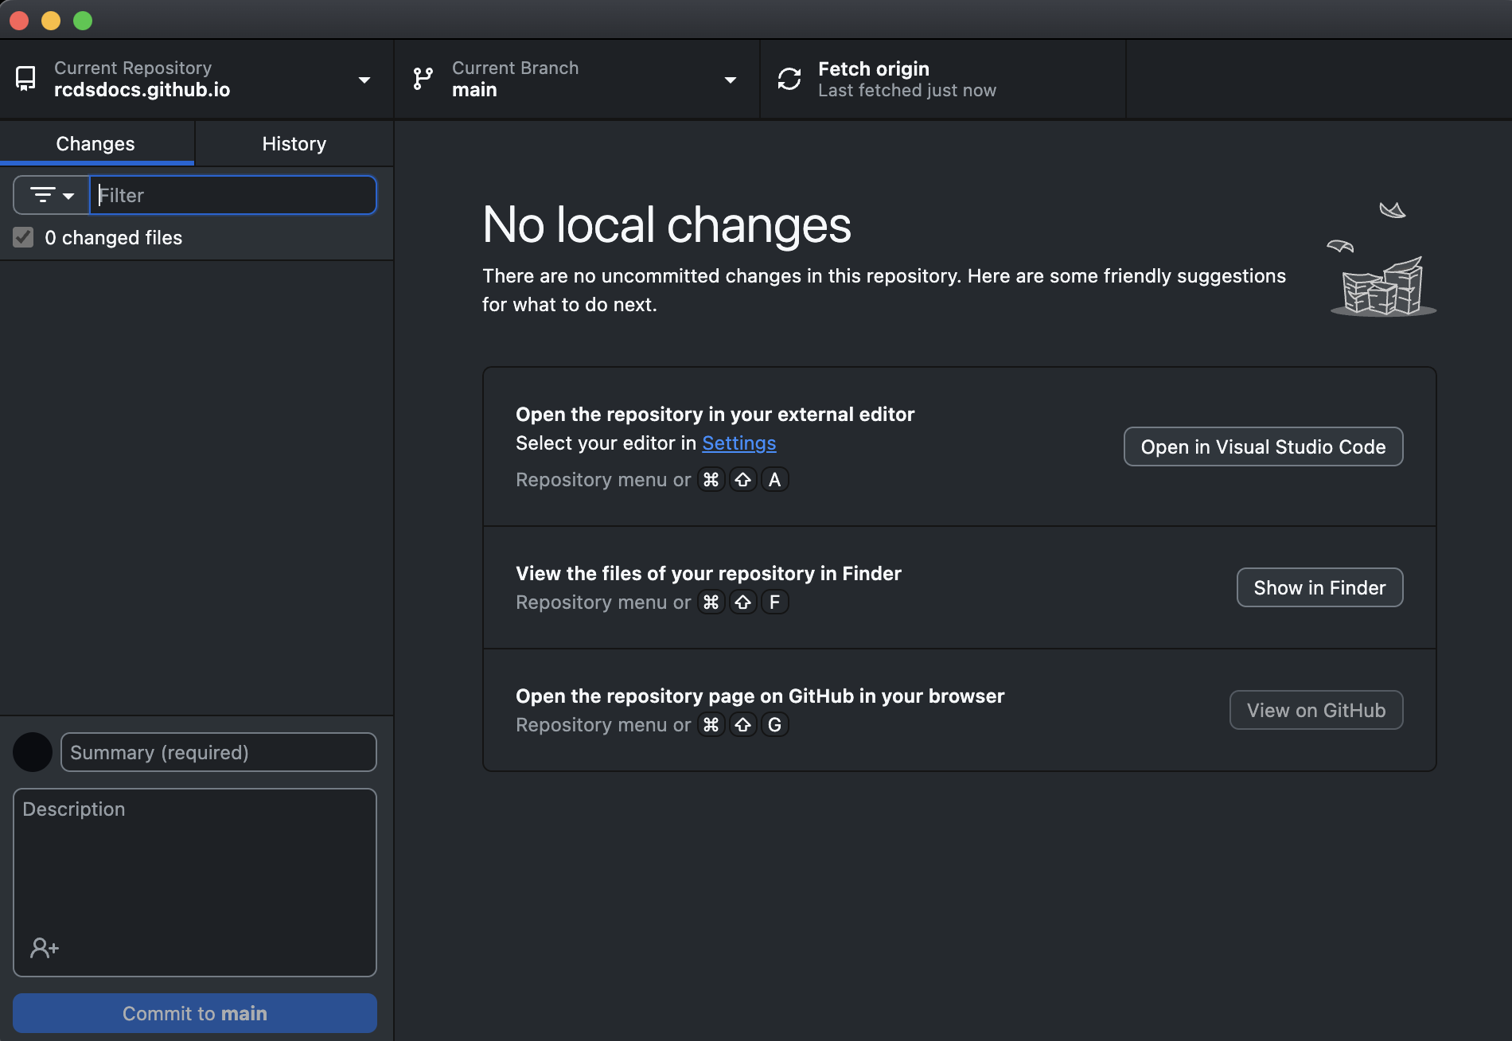
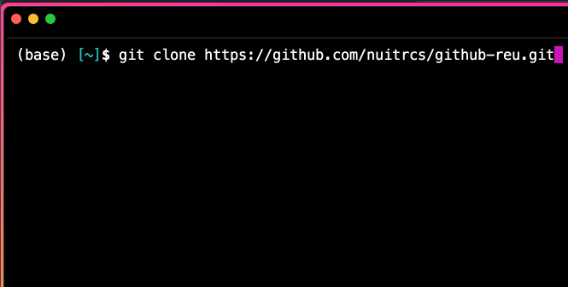
Git Tools
Browser
Terminal
App

Slide 17

Best Practices
Publish your working branches
Helpful for other to reference changes
Coordinate with lab members
Push often!
Don't push directly to main

Slide 18
What about containers and workflows?
Recipe files are often very helpful to keep in a GitHub repository
GitHub can even function as a container registry
Host built images of the containers
Workflows and pipelines have many different parts
Once you get one working, it's a great idea to store a copy of that pipeline
It makes it easy to share these pipelines with others

Slide 19
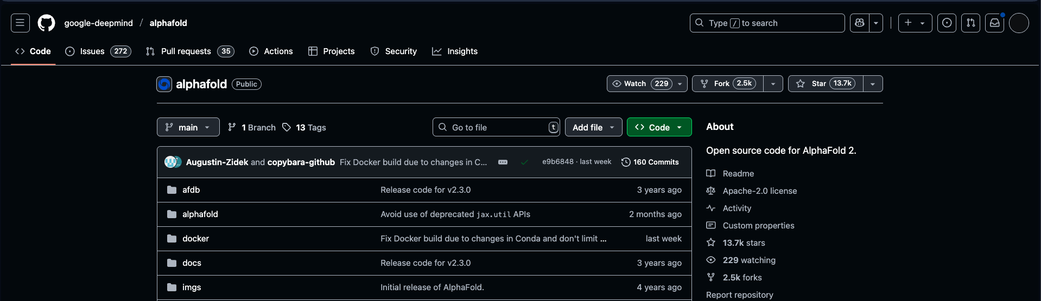
It's Git-ing Popular

